Slide 2
KEDA: Event Driven and Serverless Containers in Kubernetes
Jeff Hollan
Principal PM Manager – Azure Serverless
@jeffhollan

Slide 3
Serverless
Focus on your code – the layers that matter
Event driven code and scaling
On-demand compute
Pay-per-use

Slide 4
How we see serverless used?
Automation
“Glue” between services
Rapid APIs
Event Stream and Queue processing

Slide 5

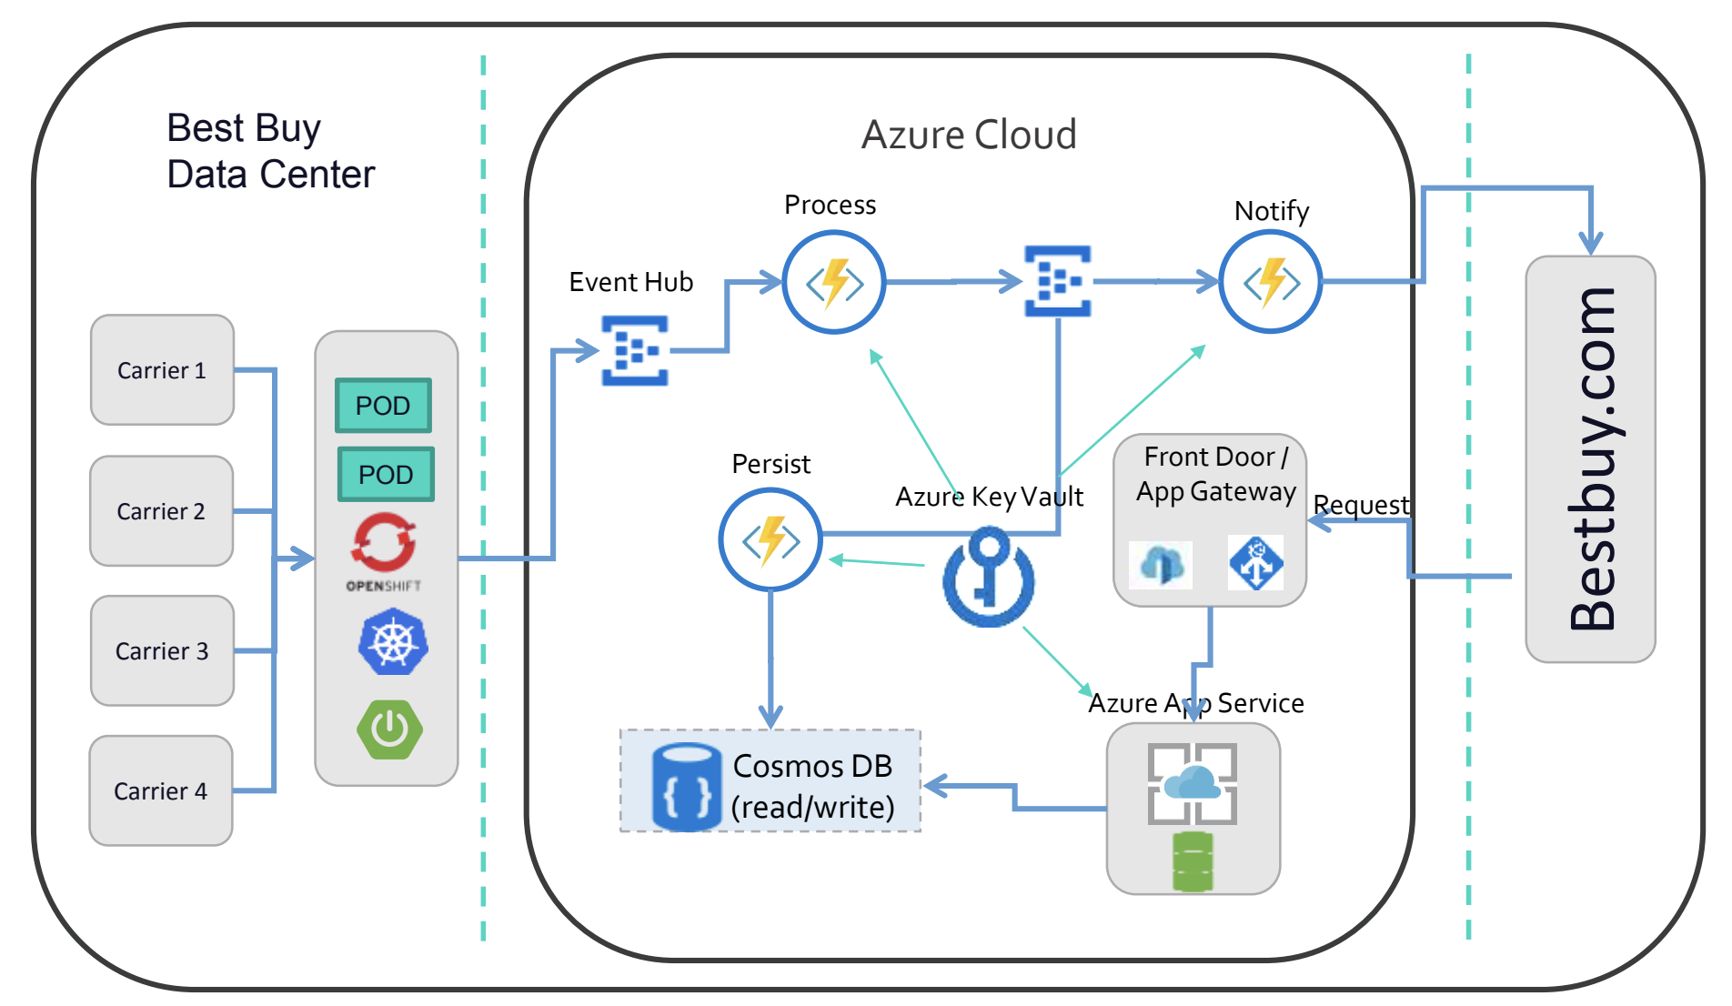
Must be able to scale to billions of events
If an error occurs, Kafka should retry / not checkpoint
Ordering must be preserved
Event Hub / Kafka
CosmosDB / Mongo

Slide 6

Default Kubernetes Scaling is not well suited for Event Driven Applications
It can only react to the symptom, not the cause

Slide 7
Kubernetes Event-Driven Autoscaling
Monitors the rate of events to proactively scale any container
Feeds the data into the Kubernetes APIs to drive scaling
Allows containers to scale to and from zero
Open source (MIT License) and onboarding to CNCF
Install into any cluster – new or existing
Extensible and pluggable scalers to grab metrics from any event source
Azure Service Bus
Azure Event Hubs
Kafka
RabbitMQ
AWS Simple Queue Service
GCP PubSub
More…
https://github.com/kedacore/keda

Slide 8
Kubernetes Cluster
KEDA Operator
Metrics API
HPA
Scalers

Slide 9

Kubernetes Cluster
Event Source
KEDA Operator
Metrics API
HPA
Scalers

Slide 10

ScaledObject.yaml
Kubernetes Cluster
Deployment
Event Source
KEDA Operator
Metrics API
HPA
Scalers

Slide 11
ScaledObject.yaml
Kubernetes Cluster
Deployment
Event Source
KEDA Operator
Metrics API
HPA
Scalers

Slide 12
Kubernetes Cluster
ScaledObject.yaml
Deployment
Event Source
KEDA Operator
Metrics API
HPA
Scalers

Slide 13
Kubernetes Cluster
ScaledObject.yaml
Deployment
Event Source
How many events are being generated?
KEDA Operator
Metrics API
HPA
Scalers

Slide 14

Kubernetes Cluster
ScaledObject.yaml
Deployment
Event Source
How many events are being generated?
KEDA Operator
Metrics API
HPA
Scalers

Slide 15
Kubernetes Cluster
ScaledObject.yaml
Deployment
Deployment
Deployment
Event Source
How many events are being generated?
KEDA Operator
Metrics API
HPA
Scalers

Slide 16
Core Principles
Don’t rebuild anything that Kubernetes offers out of the box
Single purpose, simple, non-intrusive
Works with any container and any workload
Preserve what makes messaging brokers powerful
Open and built with community

Slide 17
What about long running executions?

Slide 18
Instance 1
Instance 2
Instance 3
Instance 4

Slide 19

Instance 1
Instance 2
Instance 3
Instance 4

Slide 20


Long Running Executions + KEDA
Option 1: Leverage Kubernetes pod lifecycle
Option 2: Use the Scale Jobs functionality of KEDA to create a Kubernetes Job per event

Slide 21
Is this the best way to do event driven?

Slide 22
Event Source
Container
*
KEDA (and others)
Approach
SDK
Event Source
Event Adapter
Container
Common
Alternative Approach
HTTP
SDK

Slide 23
Event Source
Event Adapter
Container
Common
Alternative Approach
HTTP
SDK
Pros:
Developer doesn’t have to worry about Event Source or Event Source SDKs
HTTP / gRPC all the things
Cons
Developer can’t leverage native event capabilities (checkpointing, deadletter, sessions, partitions, etc.)
Some context will always be lost in the translation
Common and essential patterns like ordering and stream processing become very difficult
Responsibility for the event source mapping falls on the operator and not the developer

Slide 24
Event Source
Event Adapter
Container
Common
Alternative Approach
HTTP
SDK
Pros:
Developer doesn’t have to worry about Event Source or Event Source SDKs
HTTP / gRPC all the things
Cons
Developer can’t leverage native event capabilities (checkpointing, deadletter, sessions, partitions, etc.)
Some context will always be lost in the translation
Common and essential patterns like ordering and stream processing become very difficult
Responsibility for the event source mapping falls on the operator and not the developer
Event Source
Container
*
KEDA Approach
SDK

Slide 28
With Azure Functions

Slide 29
With Azure Functions
func init --docker-only
func kubernetes deploy --name queueTrigger --registry jeffhollan

Slide 30
Resources
📄 https://keda.sh
👩‍💻👨‍💻 https://github.com/kedacore/keda
📞 Community standups – every Thursday
🎉 Thank you 🎊

